Slide 1

AIL723/ELL888 – Lecture 00X
Graph Machine Learning​
MANIFOLS: A NON TECHNICAL INTRODUCTION
February 16th, 2024

Slide 2
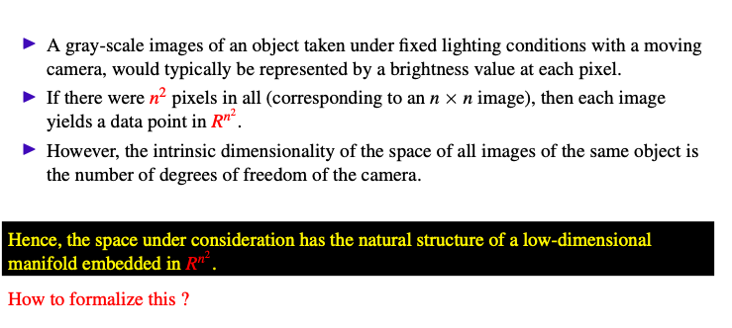
Manifold Hypothesis
2

Slide 3
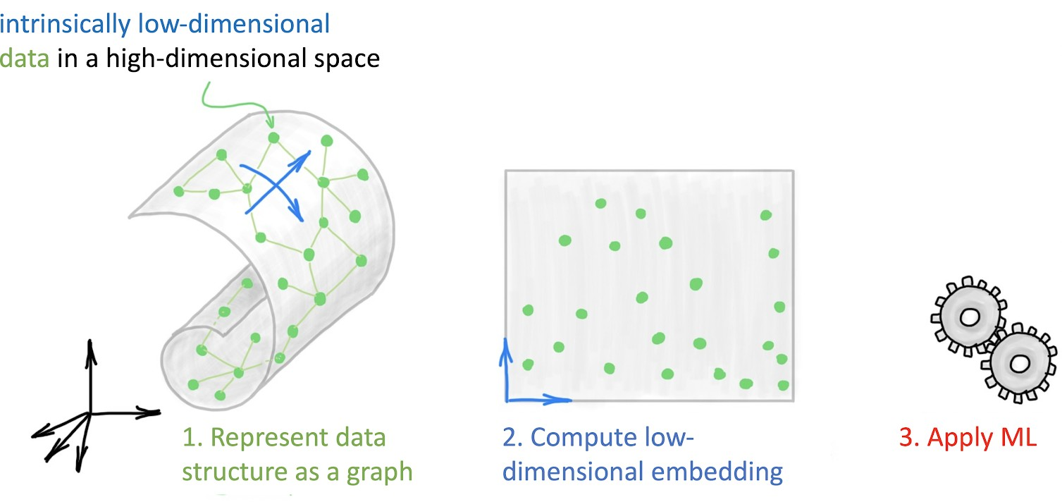
Manifold and Graphs
Laplacian

Slide 4
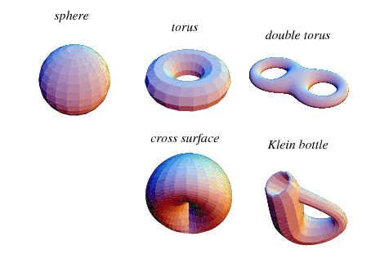
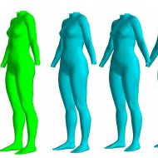
Lets first intuitively understand Manifolds

Slide 5
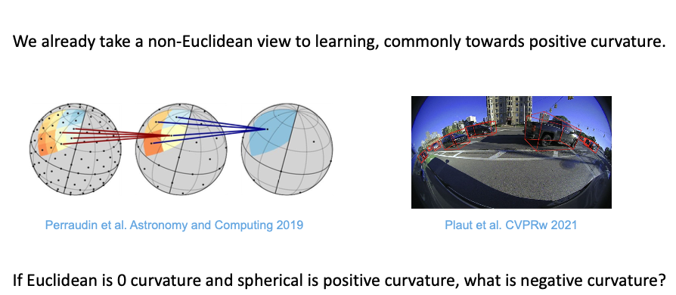
A non-Euclidean world view
5

Slide 6
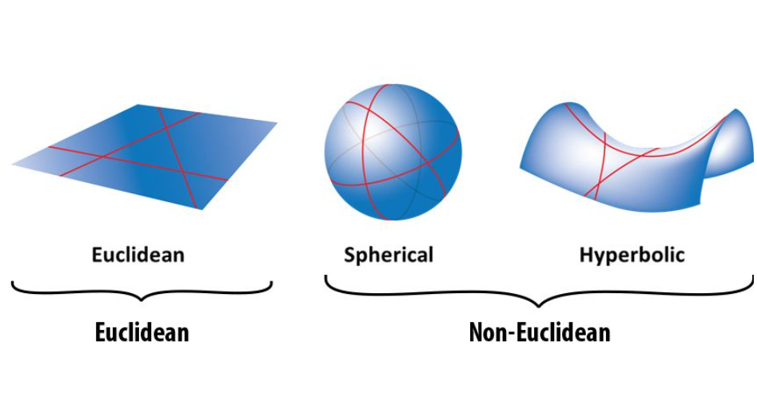
A non-Euclidean World View: Curvature

Slide 7
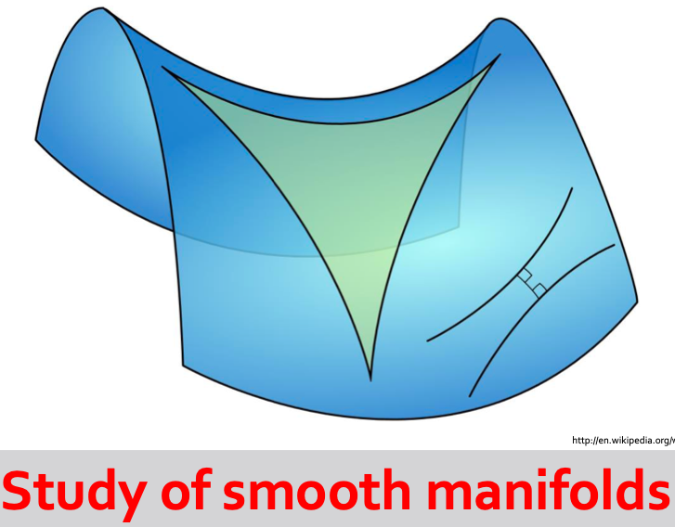
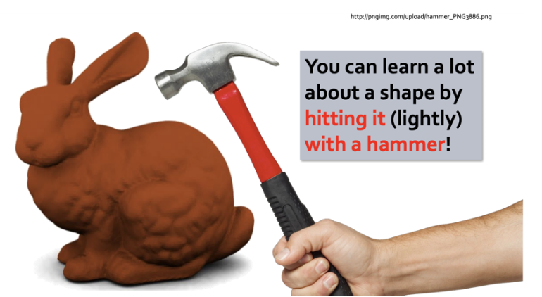
Differential Geometry

Slide 8
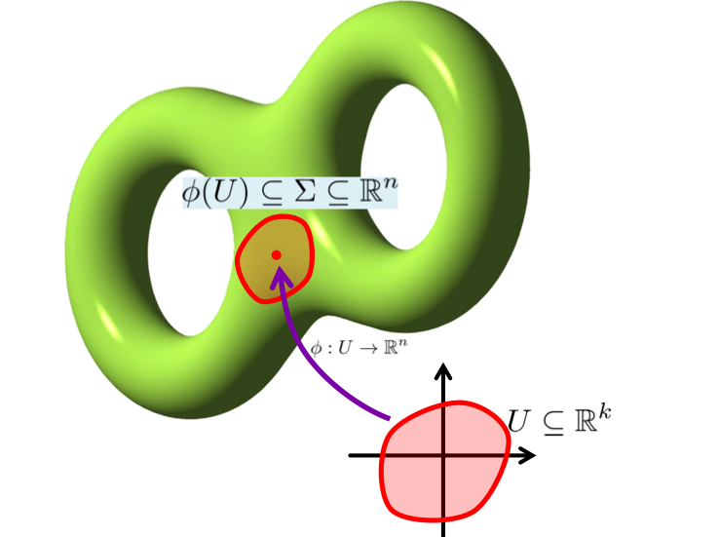
Manifold
Locally

Slide 9
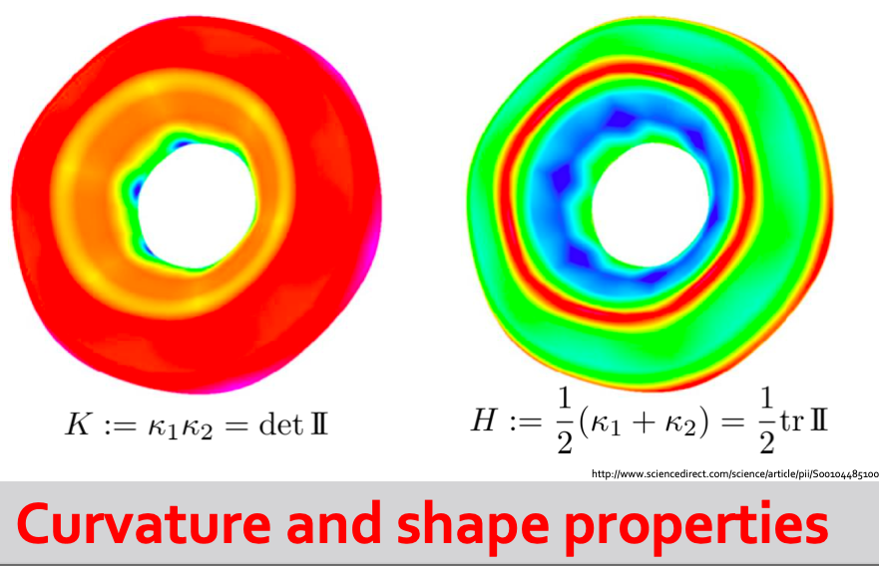
Toolbox 1

Slide 10
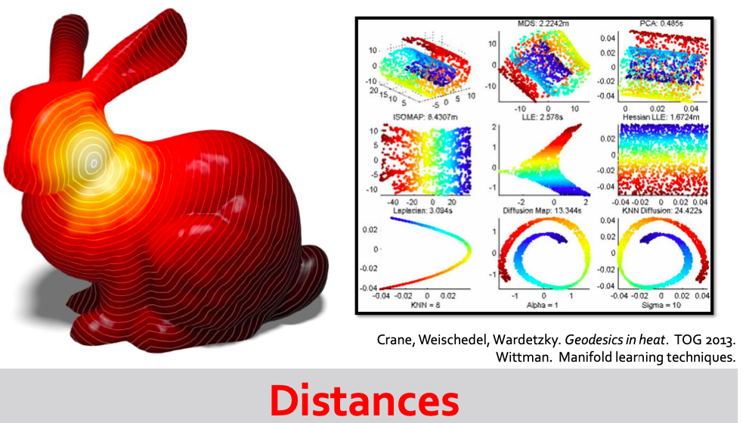
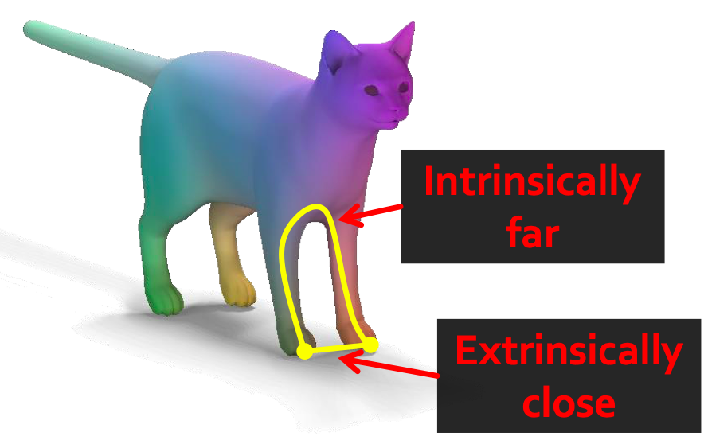
Toolbox 2

Slide 11
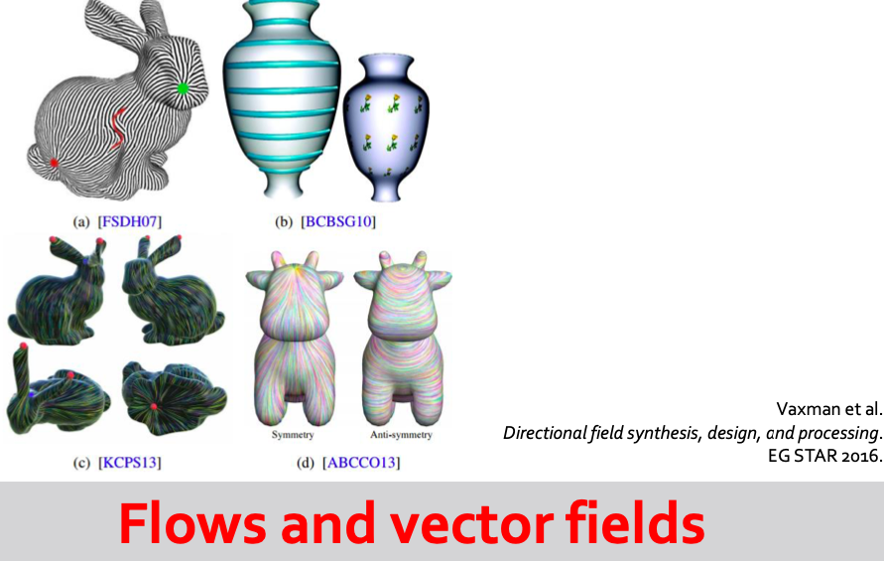
Toolbox 3

Slide 12
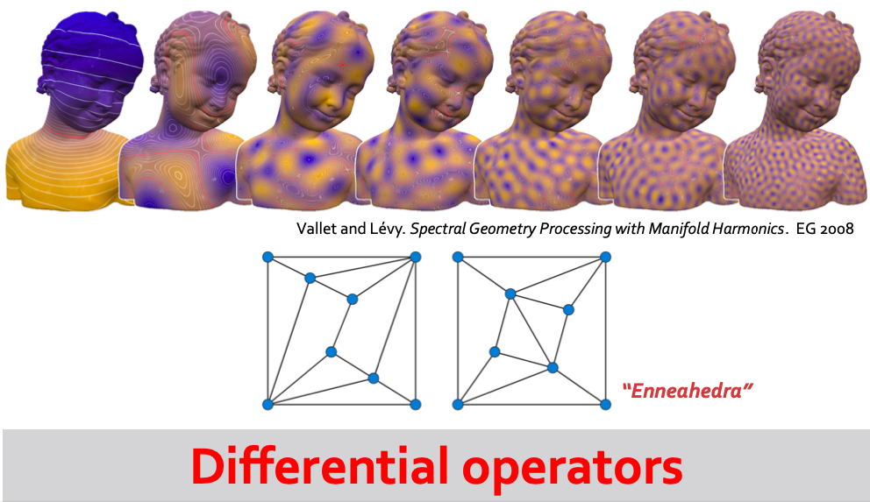
Toolbox 4

Slide 13
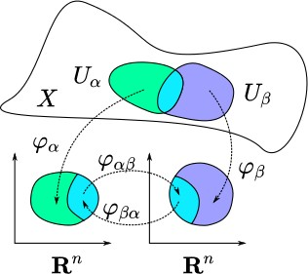
Smooth Manifolds
https://en.wikipedia.org/wiki/Atlas_(topology)
13

Slide 14

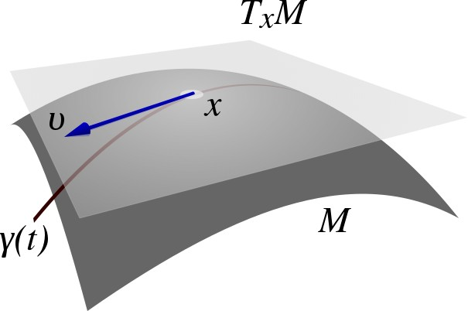
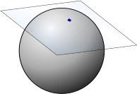

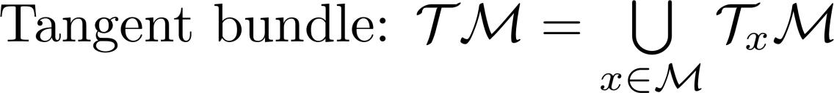
Tangent Space
https://en.wikipedia.org/wiki/Tangent_space
14

Slide 15
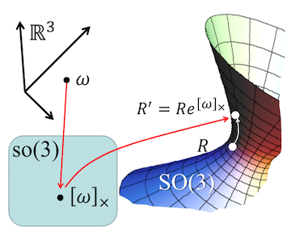
Smooth Manifolds: Examples

Slide 16
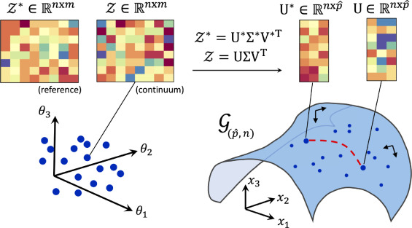
Smooth Manifolds: Examples
Grassmann Manifold

Slide 17
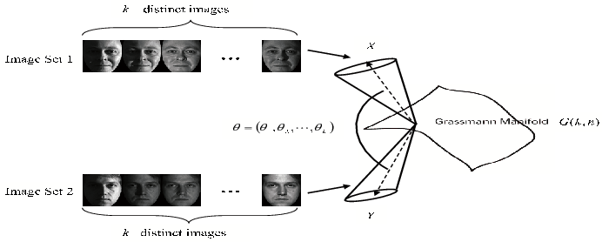
Smooth Manifolds: Examples
Grassmann Manifold

Slide 18
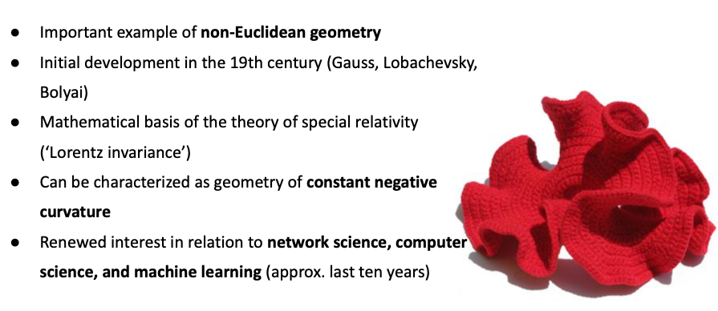
Manifolds with Negative Curvature Hyperbolic Geometry

Slide 19
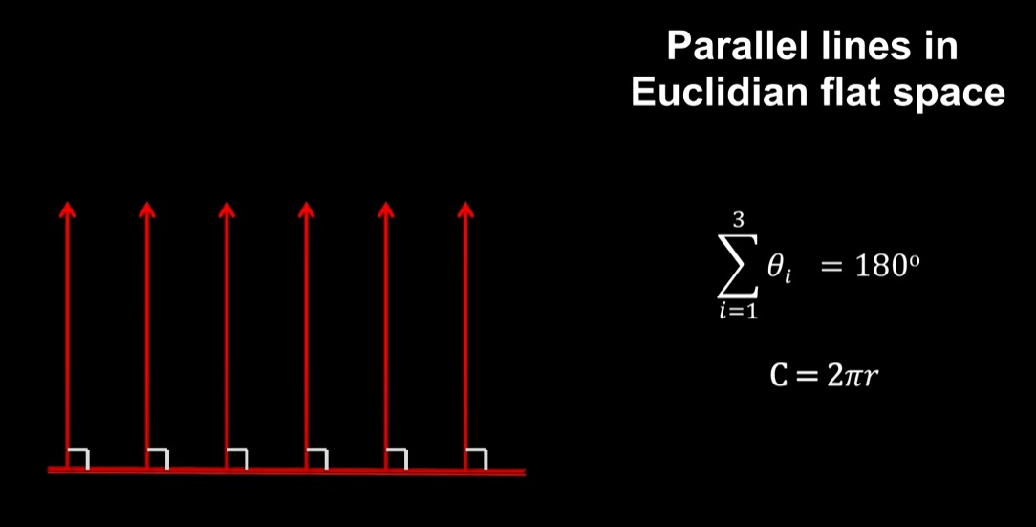

Slide 20
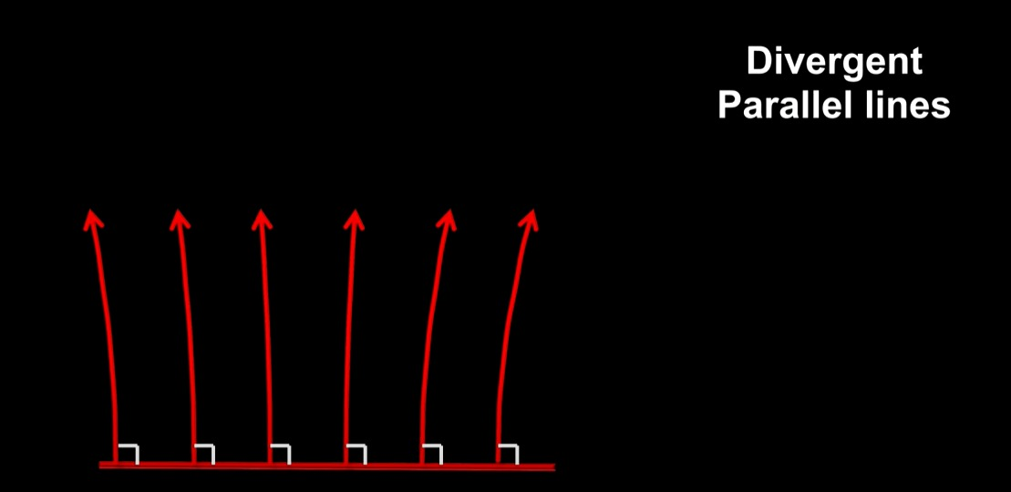

Slide 21
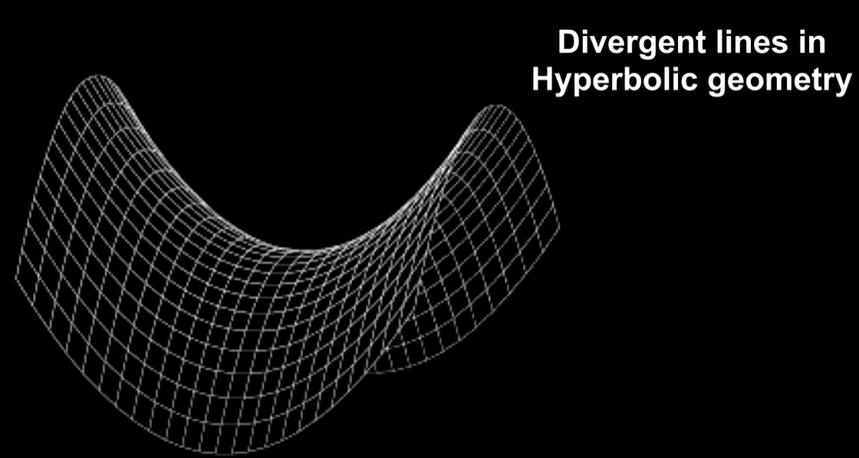

Slide 22
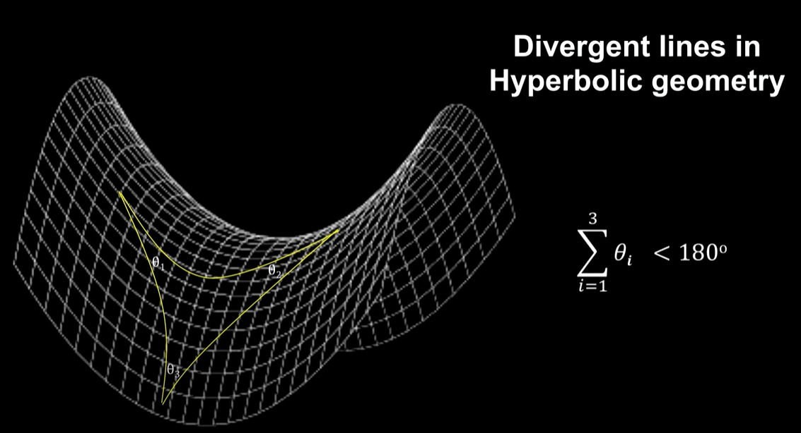

Slide 23
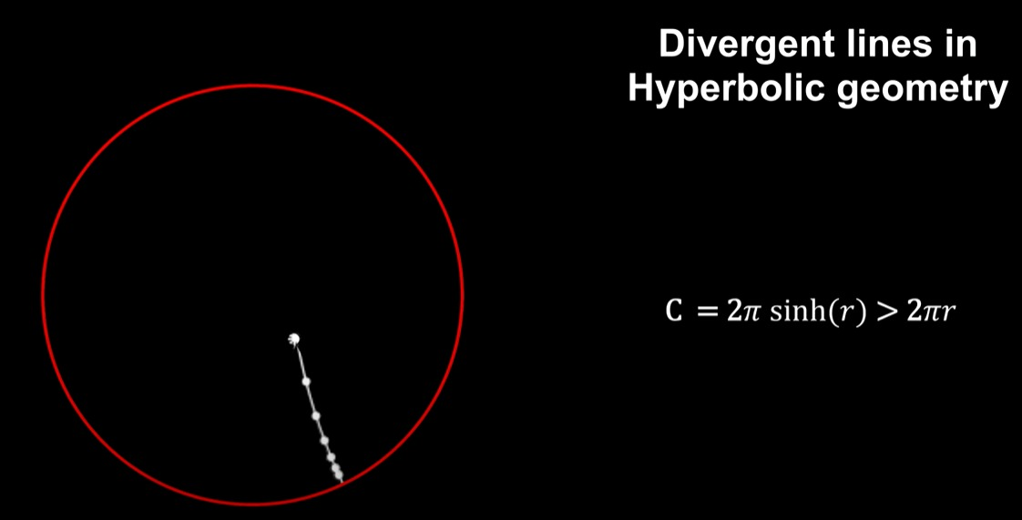

Slide 24
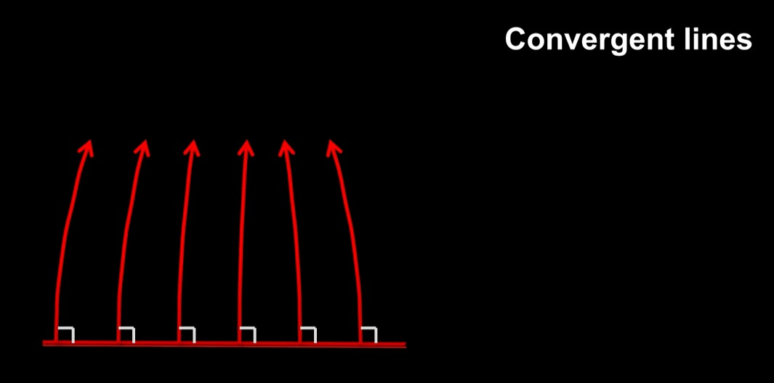

Slide 25
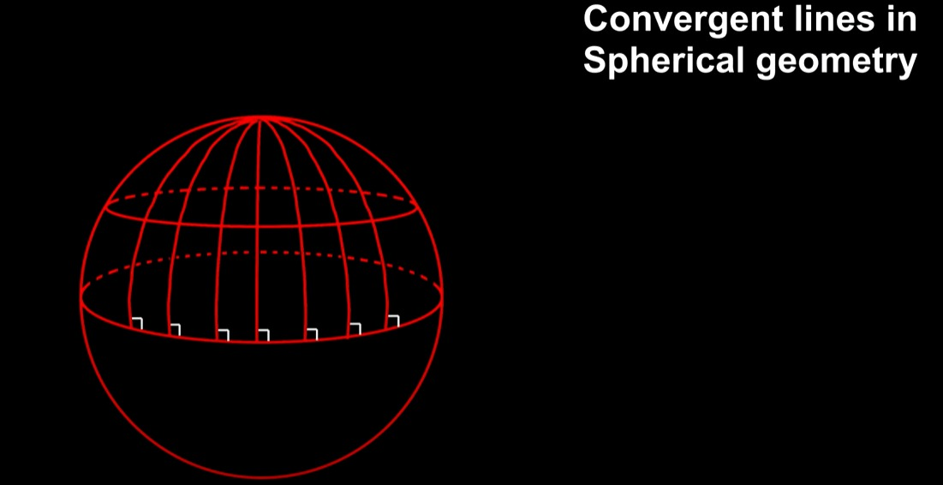

Slide 26
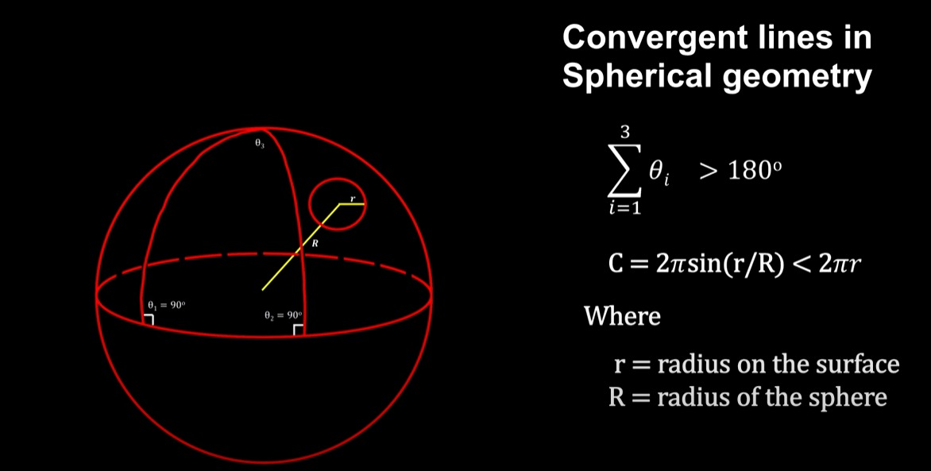

Slide 27
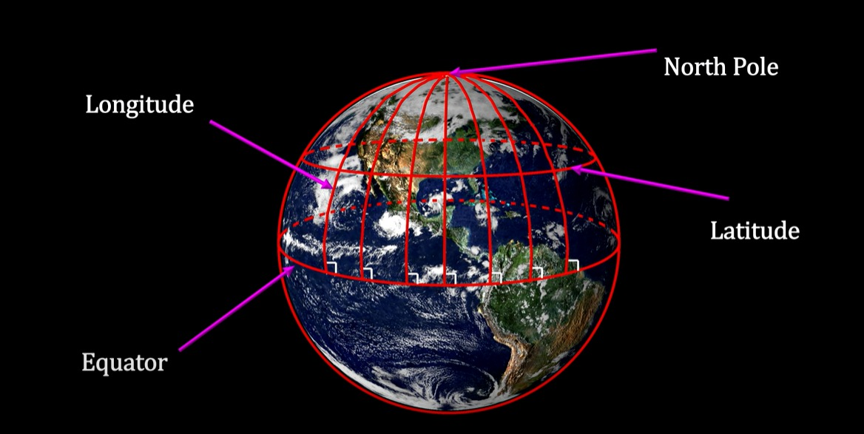

Slide 28
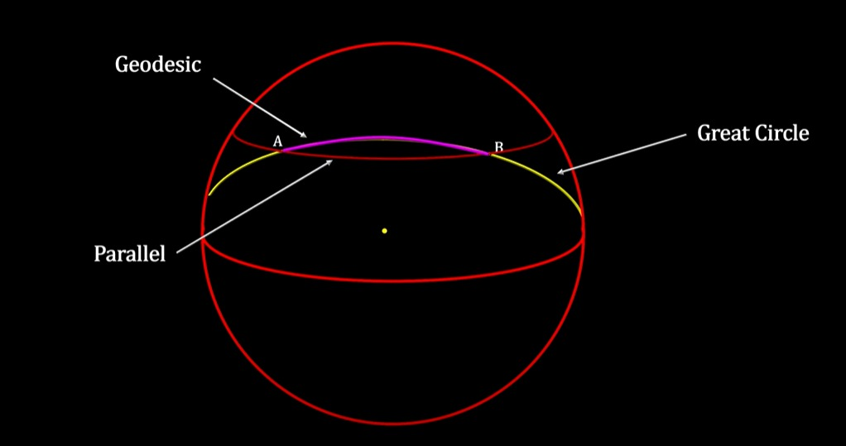

Slide 29
